Slide 1
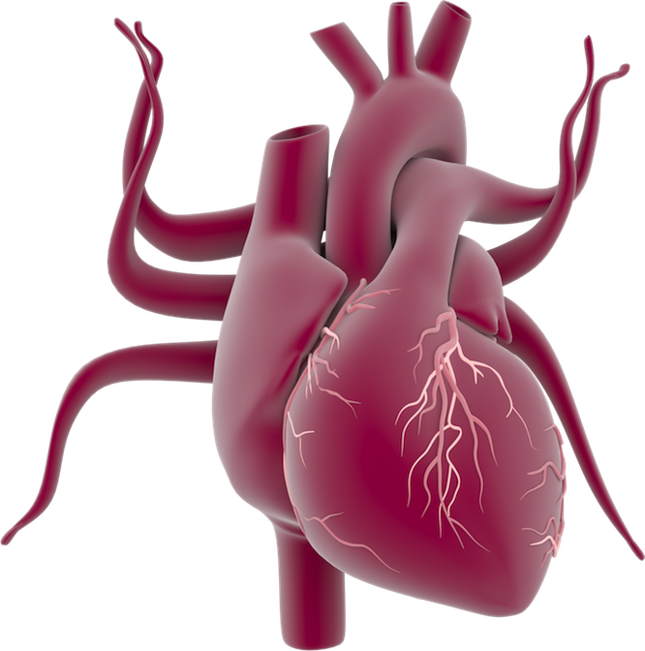
External heart anatomy
Left common carotid artery
Brachiocephalic truck
Left subclavian artery
Aorta
Superior vena cava
Left pulmonary arteries
Pulmonary trunk
Right pulmonary artery
Left pulmonary veins
Right pulmonary veins
Left atrium
Right atrium
Left cardiac vein
Right coronary artery
Right ventricle
Inferior vena cava
Left ventricle

